Slide 1
PIA 3121
8 September 2026
Root Discourses:
Realism

Slide 2
PIA 3121 Schedule
1 Sept: Tools of Analysis / Foundational Concepts
8 Sept: Realism
15 Sept: Liberalism
22 Sept: Neorealism and Neoliberalism
29 Sept: Economic Structuralism and Globalization
6 Oct: Constructivism
13 Oct: MIDTERM QUIZ
20 Oct: Ontological Security Theory
27 Oct: The English School
3 Nov: Democratization / Global Culture / Revolution
10 Nov: Critical Theory / Gender in IR / Global Civil Society
17 Nov: Chaos and Complexity in IR / Existential Risks
24 Nov: FINAL QUIZ DUE / Discussion of Group Projects
8 Dec: GROUP PAPER PROJECT DUE

Slide 3
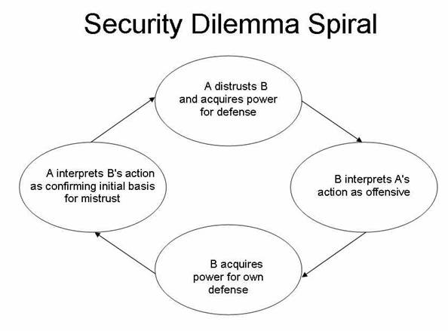

Slide 4
The 5 Sectors: Lenses for Analysis
Military
Political
Economic
Socio-Cultural
Environmental

Slide 5
A Danger in Sectoral Analysis!
The observer begins to confuse the partial reality of the sector with the total reality of the whole international system.

Slide 6
Defining “Discourse” and Specifying Its Importance

Slide 7
Defining “Discourse” and Specifying Its Importance
It could be defined simply as what people are writing and saying about a phenomenon.

Slide 8
Defining “Discourse” and Specifying Its Importance
It could be defined simply as what people are writing and saying about a phenomenon.
But the discourses of culturally powerful individuals and groups become dominant and start shaping the understandings of others.

Slide 9
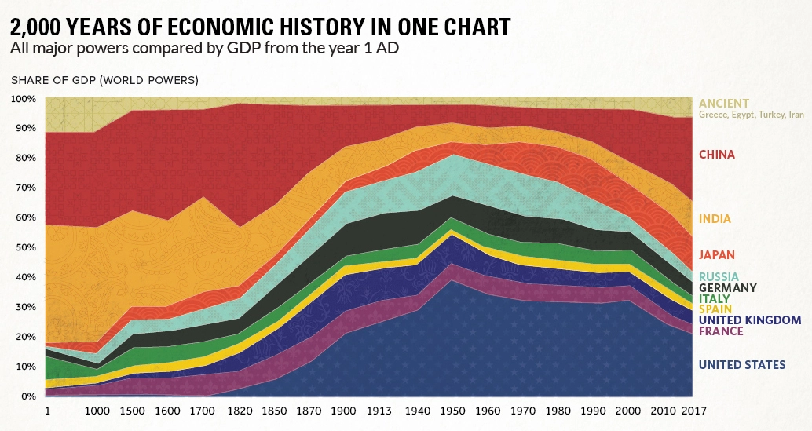
SOURCE: https://www.visualcapitalist.com/2000-years-economic-history-one-chart/

Slide 10
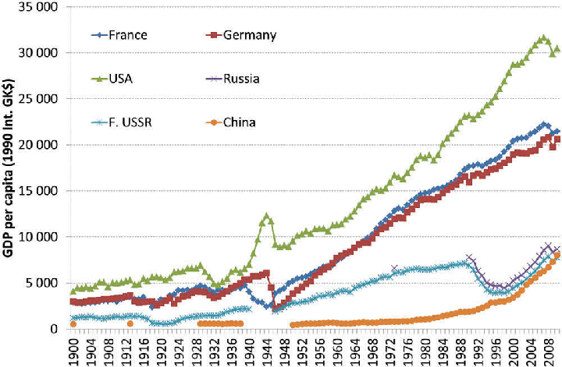
SOURCE: https://www.researchgate.net/figure/GDP-per-capita-ppp-selected-countries-1900-2010-GK-international-US-dollars_fig2_309030226

Slide 11
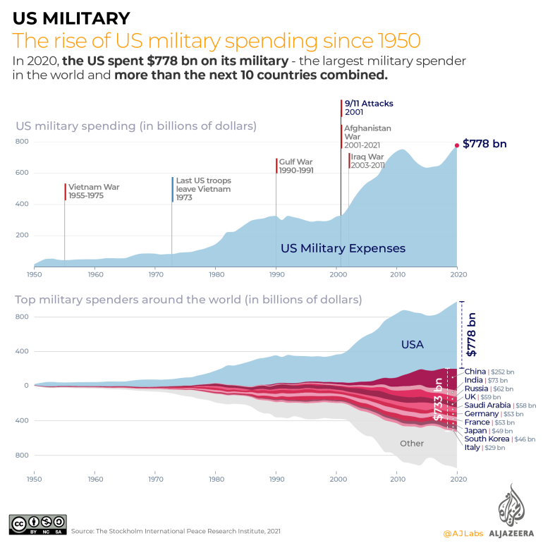

Slide 12
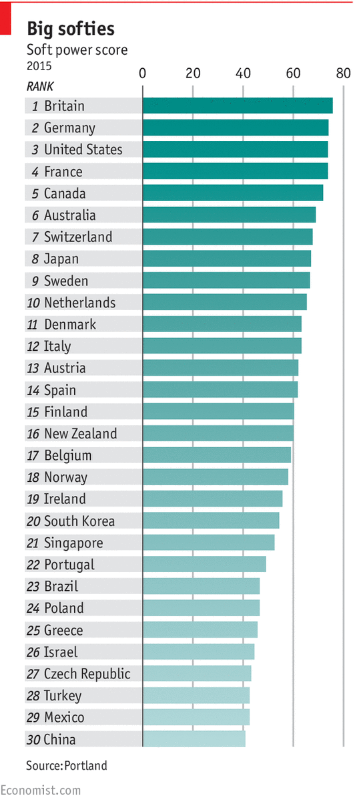
SOFT POWER: The Ability to Coax and Persuade
Three critical factors here:
Universities
Sports
Arts and Entertainment
SOURCE: https://www.economist.com/britain/2015/07/18/softly-does-it

Slide 13
Defining “Discourse” and Specifying Its Importance
It could be defined simply as what people are writing and saying about a phenomenon.
But the discourses of culturally powerful individuals and groups become dominant and start shaping the understandings of others.
Then it gets deeper:

Slide 14

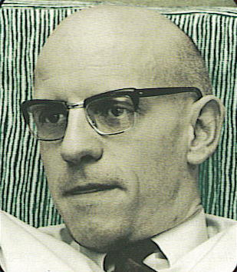

Slide 15
Discourses
Foucault argued that discourses
produce what we come to see as
real, and therefore what becomes real.
They determine what can (not just “may”)
be said, and even what can be thought.

Slide 16
Discourses
Foucault argued that discourses
produce what we come to see as
real, and therefore what becomes real.
They determine what can (not just “may”)
be said, and even what can be thought.
IR theories such as Realism and Liberalism can be regarded as “root discourses" that established what became deep-seated, historically-rooted grooves of thought.

Slide 17
Discourses
Foucault argued that discourses
produce what we come to see as
real, and therefore what becomes real.
They determine what can (not just “may”)
be said, and even what can be thought.
IR theories such as Realism and Liberalism can be regarded as “root discourses” that established what became deep-seated, historically-rooted grooves of thought. These grooves powerfully channeled and conditioned later thinking after they became, through repetition, “obvious,” “natural,” self-evident truths.

Slide 18
What’s so “root” about Realism as an IR Discourse?
Realism is the oldest “school” of thought in IR

Slide 19
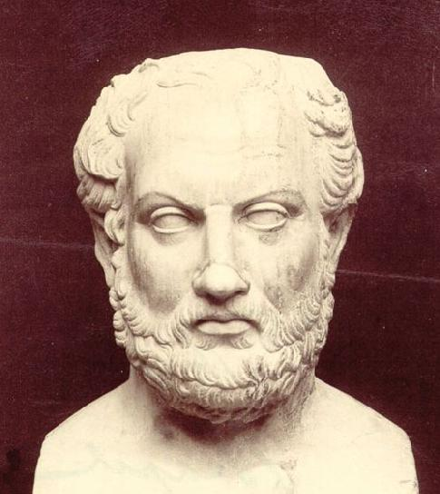
Thucydides
(c. 460 BCE - 395 BCE)
First known Realist in the history of humanity—although very shortly thereafter, people thinking along similar lines appeared in China and elsewhere. Thucydides analyzed the Peloponnesian War (431-404 BCE) and concluded (among many other things):
“The strong do what they can, and the weak suffer what they must.”

Slide 20
Thucydides: "The growth in the power of Athens, and the alarm which this inspired in [Sparta], made war inevitable.”
But was Athens’ acquisition of power purely for defensive reasons?

Slide 21
What’s so “root” about Realism as an IR Discourse?
Realism is the oldest “school” of thought in IR
Realism dominated the study of IR in America from 1939 until the 1980s, and shared the dominant position from the 1980s until basically today. (Not always in the 1990s, though.)

Slide 22
What’s so “root” about Realism as an IR Discourse?
Realism is the oldest “school” of thought in IR
Realism dominated the study of IR in America from 1939 until the 1980s, and shared the dominant position from the 1980s until basically today. (Not always in the 1990s, though.)
Realism did NOT always dominate globally before 1939. In Western Europe, international lawyers were increasingly influential from the 1600s on. “Idealists” were dominant in the 1920s and 1930s. In East Asia, the China-centered Tribute System flourished.

Slide 23
What’s so “root” about Realism as an IR Discourse?
Realism is the oldest “school” of thought in IR
Realism dominated the study of IR in America from 1939 until the 1980s, and shared the dominant position from the 1980s until basically today. (Not always in the 1990s, though.)
Realism did NOT always dominate globally before 1939. In Western Europe, international lawyers were increasingly influential from the 1600s on. “Idealists” were dominant in the 1920s and 1930s. In East Asia, the China-centered Tribute System flourished.
But after 1939, and continuing through the Cold War, realism became dominant in America (and the Soviet Union, and China), and American IR theory became the most influential globally.

Slide 24
What’s so “root” about Realism as an IR Discourse?
Realism is the oldest “school” of thought in IR
Realism dominated the study of IR in America from 1939 until the 1980s, and shared the dominant position from the 1980s until basically today. (Not always in the 1990s, though.)
Realism did NOT always dominate globally before 1939. In Western Europe, international lawyers were increasingly influential from the 1600s on. “Idealists” were dominant in the 1920s and 1930s. In East Asia, the China-centered Tribute System flourished.
But after 1939, and continuing through the Cold War, realism became dominant in America (and the Soviet Union, and China), and American IR theory became the most influential globally.
As ever, though, we have to ask whether this means that realism was RIGHT, empirically, or dominant simply because the powerful states were promoting and practicing Realism?

Slide 25
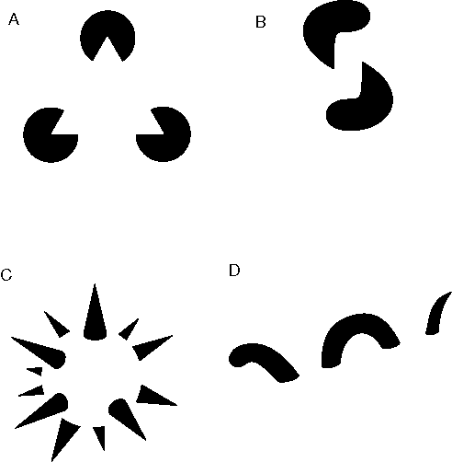
Reification:
Which comes first, anarchy or the belief that anarchy is a real source of threat that states must counter (by creating anarchy)?

Slide 26
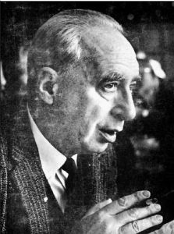
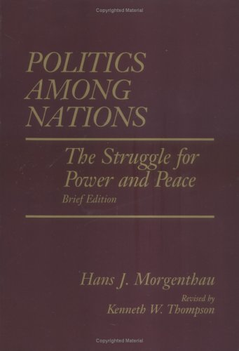
Hans J. Morgenthau (1904-1980)

Slide 27
Morgenthau’s “Six Principles of Political Realism”
1. International politics – or politics among states – is governed by laws, laws which can be uncovered through reasoned analysis.

Slide 28
Morgenthau’s “Six Principles of Political Realism”
1. International politics – or politics among states – is governed by laws, laws which can be uncovered through reasoned analysis. The consciousness or identity/culture of the humans who run states doesn’t matter much.

Slide 29
Morgenthau’s “Six Principles of Political Realism”
2. Statesmen think and act in terms of interest defined as power.

Slide 30
Morgenthau’s “Six Principles of Political Realism”
2. Statesmen think and act in terms of interest defined as power.
This tends to induce PRUDENCE in foreign and security policymaking, based on careful and rational decision- making.

Slide 31
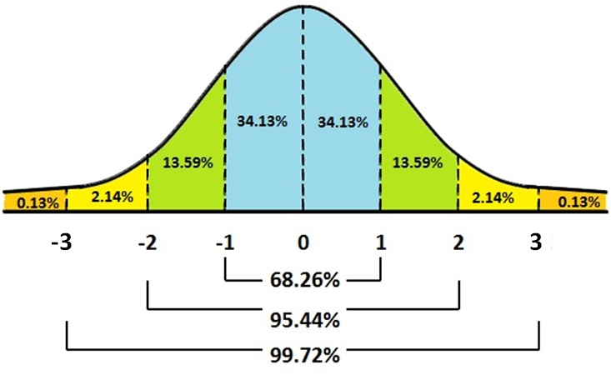
What about Trump?

Slide 32
Morgenthau’s “Six Principles of Political Realism”
3. The principle that statesmen think and act in terms of interest defined as power is universally valid, in all times and places.

Slide 33
Thucydides
(c. 460 BCE - 395 BCE)
First known Realist in the history of humanity—although very shortly thereafter, people thinking along similar lines appeared in China and elsewhere. Thucydides analyzed the Peloponnesian War (431-404 BCE) and concluded (among many other things):
“The strong do what they can, and the weak suffer what they must.”

Slide 34
Morgenthau’s “Six Principles of Political Realism”
4. Universal moral laws or globe-wide cultural values cannot be used to judge a state’s behavior. States have their own morality.

Slide 35
Morgenthau’s “Six Principles of Political Realism”
4. Universal moral laws or globe-wide cultural values cannot be used to judge a state’s behavior. States have their own morality.
EXCEPT: A state has no right to sacrifice “its” nation in pursuit of some grand moral vision. All states have a moral requirement to defend or advance the “national interest”

Slide 36
Morgenthau’s “Six Principles of Political Realism”
5. States must not try to universalize their particular moral vision. They must not be preachy and morally presumptuous.

Slide 37
Morgenthau’s “Six Principles of Political Realism”
6. Politics and international relations are distinct from other social spheres and must be analyzed as such.
You can’t assume that the international political realm functions like an economy, or a society, or a network, etc.

Slide 38
Hans J. Morgenthau (1904-1980)

Slide 39
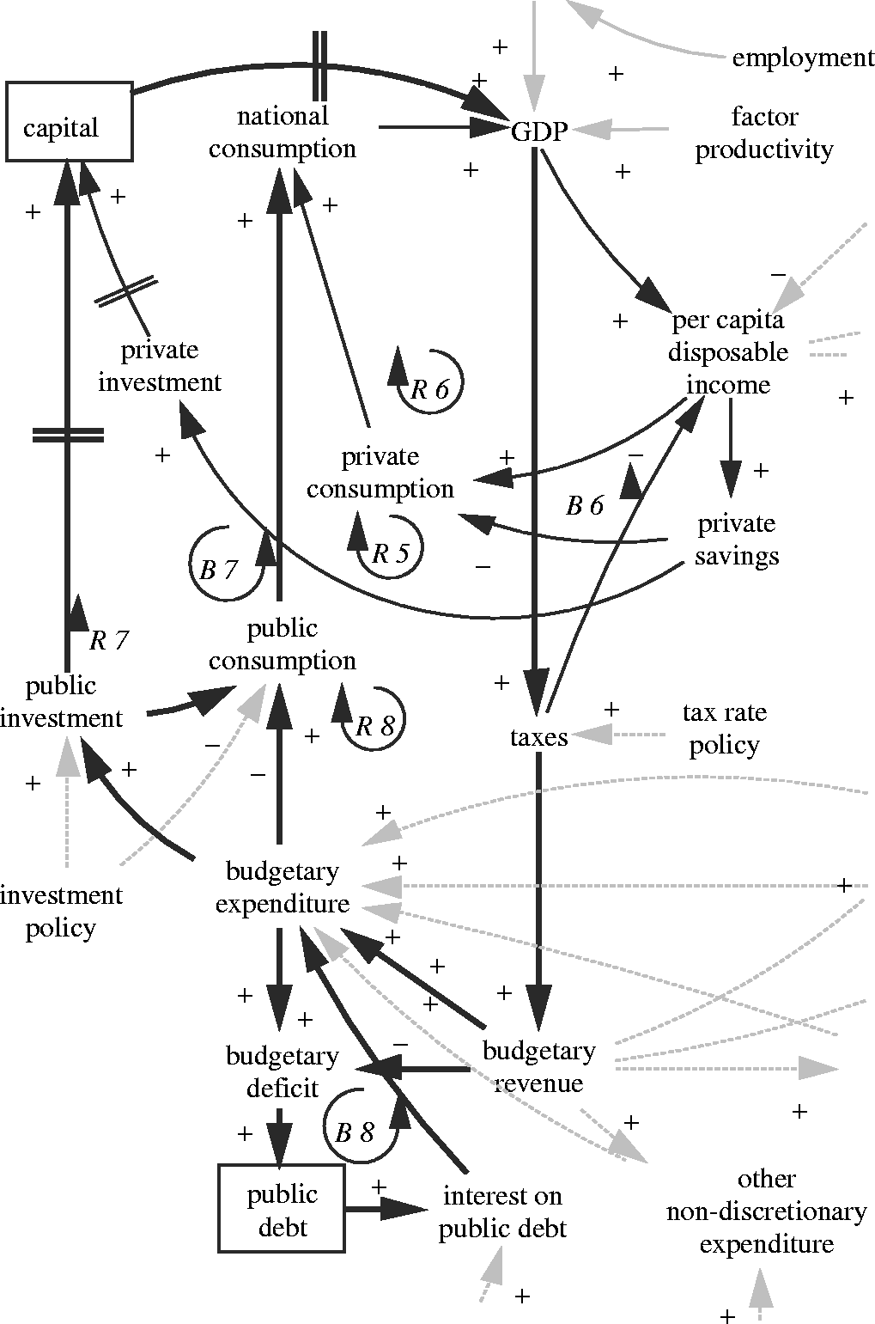
NEO-Realism
Owing to its scientific rigor, conceptual clarity, elegance of explanation, and demonstrated successes in predicting the future, Economics rapidly became the model social science to emulate for many IR scholars in US political science departments in the 1950s and ‘60s.
Such was not the case in Europe (including Britain), Australia, and other places.

Slide 40
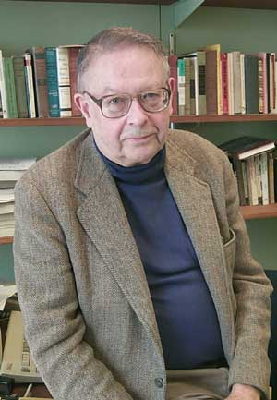
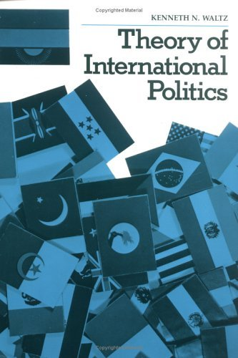
Neorealism born in the 1970s

Slide 41
The Neorealists’ Two Main Objectives
1. Make Classical Realism more scientific and rigorous by moving it away from history, philosophy, and law, and toward economics and the natural sciences – while still adhering to Morgenthau’s Six Principles.

Slide 42
The Neorealists’ Two Main Objectives
1. Make Classical Realism more scientific and rigorous by moving it away from history, philosophy, and law, and toward economics and the natural sciences – while still adhering to Morgenthau’s Six Principles.
2. Put down a theoretical challenge from students of transnational relations and interdependence (“neoliberals,” in the IR sense).

Slide 43
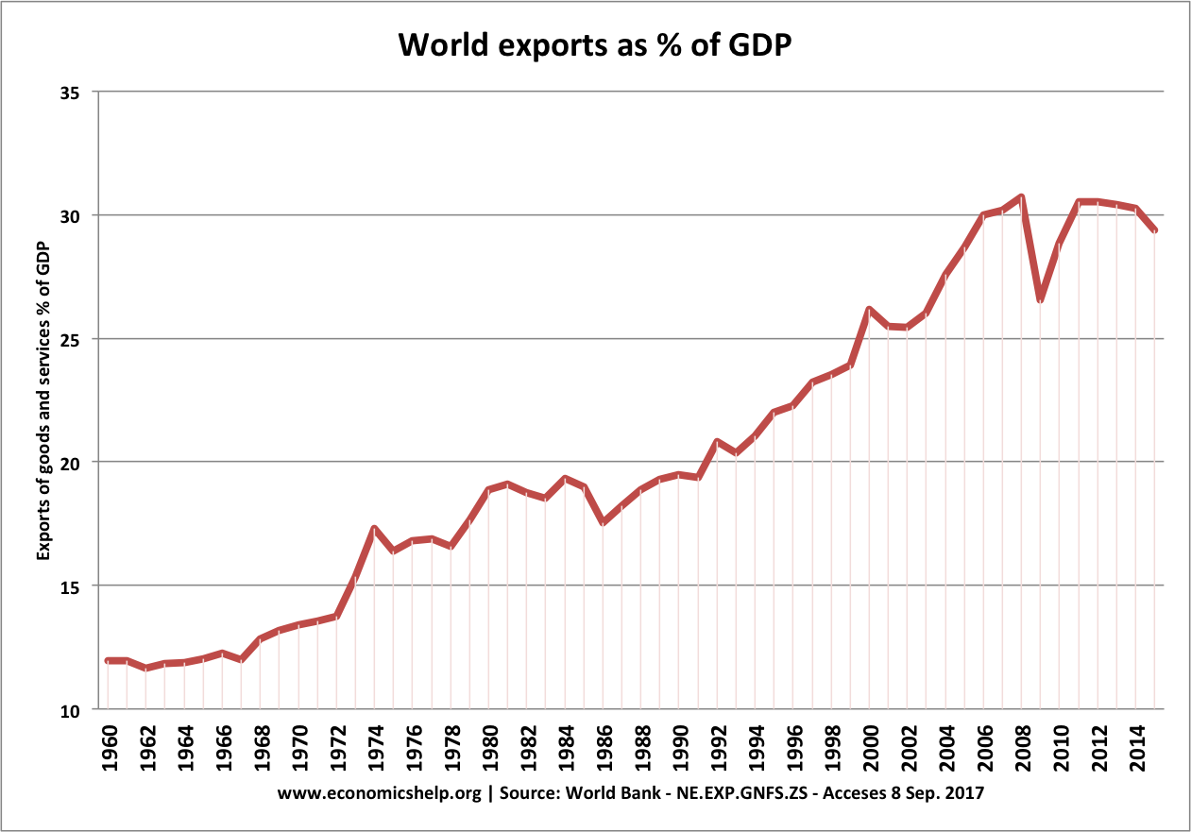

Slide 44
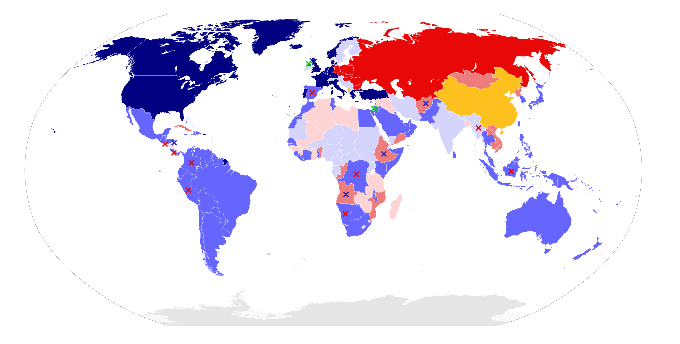
Stable Cold War Bipolarity, 1980
Red x’s: Communist insurgencies challenging US-supporting states
Blue x’s: Right-wing insurgencies challenging USSR-supporting states

Slide 45
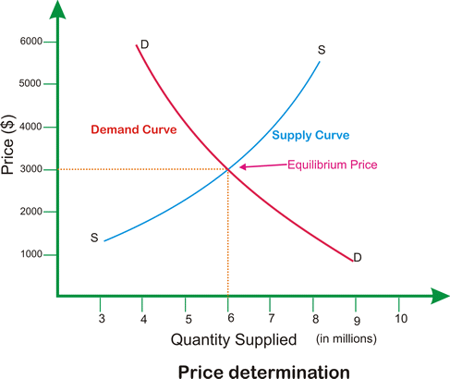
To Waltz, the international system was very much like a market

Slide 46
The outcome of competitive state jostling is international STRUCTURE
Structure: the principles by which units are arranged into an international system, how units are differentiated from each other, and how they stand in relation to each other in terms of relative capabilities.

Slide 47
The Neorealists’ Three Dimensions to
International Structure

Slide 48
The Neorealists’ Three Dimensions to
International Structure
1. Ordering Principle. This is binary: either hierarchy or anarchy.

Slide 49
The Neorealists’ Three Dimensions to
International Structure
1. Ordering Principle. This is binary: either hierarchy or anarchy.
2. Functional Differentiation of Units: Because the system is anarchic and survival is paramount, all states must perform the same basic tasks. They are functionally similar, regardless of whether they are democracies or dictatorships. Waltz treats the insides of states as black boxes.

Slide 50
The Neorealists’ Three Dimensions to
International Structure
1. Ordering Principle. This is binary: either hierarchy or anarchy.
2. Functional Differentiation of Units: Because the system is anarchic and survival is paramount, all states must perform the same basic tasks. They are functionally similar, regardless of whether they are democracies or dictatorships. Waltz treats the insides of states as black boxes.
3. Distribution of Capabilities. This is where systems differ. How is power distributed? Is it concentrated in one state, two (Bipolarity, like the Cold War), or many (Multipolarity)? This distribution dictates the nature of international competition.

Slide 51
Why Neorealists Consider that
Bipolarity Is More Stable than Multipolarity

Slide 52
Why Neorealists Consider that
Bipolarity Is More Stable than Multipolarity
1. Simple math: A system with five great powers has ten potential conflict pairings. A bipolar system has only one. This reduces the opportunities for great power wars to break out.

Slide 53
Why Neorealists Consider that
Bipolarity Is More Stable than Multipolarity
1. Simple math: A system with five great powers has ten potential conflict pairings. A bipolar system has only one. This reduces the opportunities for great power wars to break out.
2. Easier Deterrence & Less Miscalculation: In a bipolar world, threats are clearer, and the adversary is unambiguous. The two superpowers are preoccupied with each other's every move, leading to more careful calculation and fewer catastrophic misjudgments about capabilities or resolve.

Slide 54
Why Neorealists Consider that
Bipolarity Is More Stable than Multipolarity
1. Simple math: A system with five great powers has ten potential conflict pairings. A bipolar system has only one. This reduces the opportunities for great power wars to break out.
2. Easier Deterrence & Less Miscalculation: In a bipolar world, threats are clearer, and the adversary is unambiguous. The two superpowers are preoccupied with each other's every move, leading to more careful calculation and fewer catastrophic misjudgments about capabilities or resolve.
3. Reduces “Buck-Passing” and “Chain-Ganging”: Buck-Passing is when facing a rising threat, states in a multipolar system might hope another great power will bear the costs of confronting it (i.e., "pass the buck"). This can allow an aggressor to grow too powerful.

Slide 55
Why Neorealists Consider that
Bipolarity Is More Stable than Multipolarity
1. Simple math: A system with five great powers has ten potential conflict pairings. A bipolar system has only one. This reduces the opportunities for great power wars to break out.
2. Easier Deterrence & Less Miscalculation: In a bipolar world, threats are clearer, and the adversary is unambiguous. The two superpowers are preoccupied with each other's every move, leading to more careful calculation and fewer catastrophic misjudgments about capabilities or resolve.
3. Reduces “Buck-Passing” and “Chain-Ganging”: Buck-Passing is when facing a rising threat, states in a multipolar system might hope another great power will bear the costs of confronting it (i.e., "pass the buck"). This can allow an aggressor to grow too powerful. Chain-Ganging is when states feel their own security is so intertwined with their allies' security that they get dragged into peripheral conflicts (e.g., the alliance system before WWI).

Slide 56
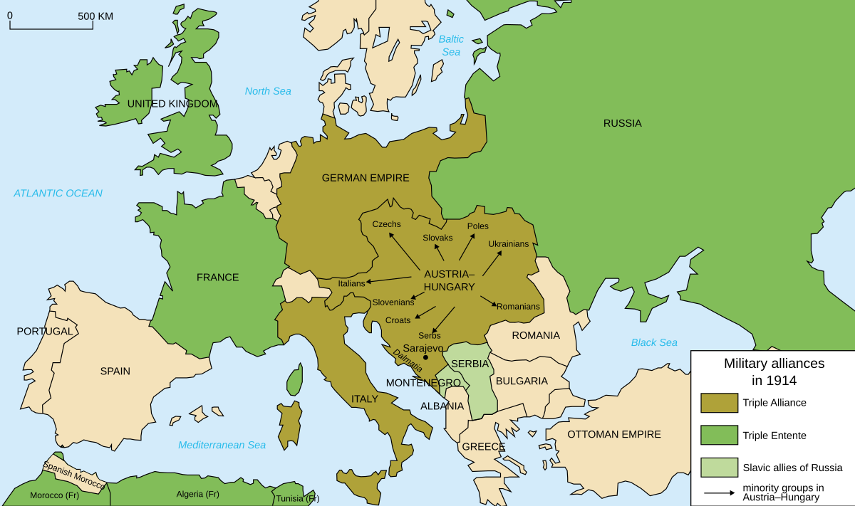
“Chain-Ganging” Under Multipolarity
Leads to World War I

Slide 57
Stable Cold War Bipolarity, 1980
Red x’s: Communist insurgencies challenging US-supporting states
Blue x’s: Right-wing insurgencies challenging USSR-supporting states

Slide 58
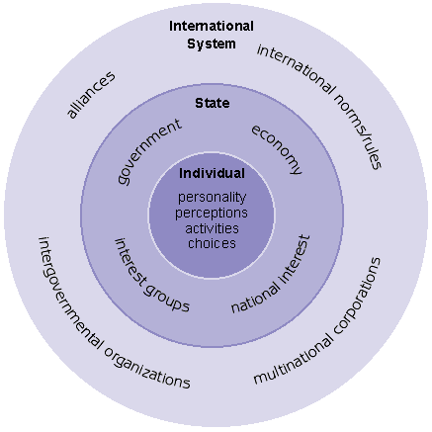
ANARCHY!

Slide 59
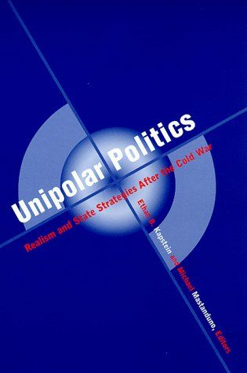

Michael Mastanduno
(seeks in 1999 to update Neorealism itself)

Slide 60
Mastanduno’s Four Fundamental Realist Assumptions
1. The most important actors in world politics are territorially-organized entities.

Slide 61
Mastanduno’s Four Fundamental Realist Assumptions
1. The most important actors in world politics are territorially-organized entities.
2. State behavior can be explained as the product of rational decision-making.

Slide 62
Mastanduno’s Four Fundamental Realist Assumptions
1. The most important actors in world politics are territorially-organized entities.
2. State behavior can be explained as the product of rational decision-making.
3. All states seek power, but they don’t all necessarily seek to maximize power.

Slide 63
Mastanduno’s Four Fundamental Realist Assumptions
1. The most important actors in world politics are territorially-organized entities.
2. State behavior can be explained as the product of rational decision-making.
3. All states seek power, but they don’t all necessarily seek to maximize power.
4. Relations among states are inherently competitive as states strive to improve their relative positions.

Slide 64
Neoclassical Realism (NCR):
A New School of Thought from the 1990s-2010s

Slide 65
Neoclassical Realism (NCR):
A New School of Thought from the 1990s-2010s
It agrees that the systemic distribution of power is the primary driver of foreign policy (the independent variable). BUT: Systemic pressures are filtered through domestic-level intervening variables.

Slide 66
Neoclassical Realism (NCR):
A New School of Thought from the 1990s-2010s
It agrees that the systemic distribution of power is the primary driver of foreign policy (the independent variable). BUT: Systemic pressures are filtered through domestic-level intervening variables.
1. Systemic Pressures (Independent Variable): Anarchy, distribution of capabilities (e.g., rise of a rival power).

Slide 67
Neoclassical Realism (NCR):
A New School of Thought from the 1990s-2010s
It agrees that the systemic distribution of power is the primary driver of foreign policy (the independent variable). BUT: Systemic pressures are filtered through domestic-level intervening variables.
1. Systemic Pressures (Independent Variable): Anarchy, distribution of capabilities (e.g., rise of a rival power).
2. Intervening Variables (Domestic Factors):
a. Leader Perceptions: How do leaders understand the external threats and opportunities? Are they risk-averse or risk-acceptant?
b. State-Society Relations: How easily can leaders mobilize societal resources for foreign policy goals? (e.g., tax revenue, military conscription).
c. Domestic Institutions: Democratic checks and balances, powerful bureaucracies, etc.

Slide 68
Neoclassical Realism (NCR):
A New School of Thought from the 1990s-2010s
It agrees that the systemic distribution of power is the primary driver of foreign policy (the independent variable). BUT: Systemic pressures are filtered through domestic-level intervening variables.
1. Systemic Pressures (Independent Variable): Anarchy, distribution of capabilities (e.g., rise of a rival power).
2. Intervening Variables (Domestic Factors):
a. Leader Perceptions: How do leaders understand the external threats and opportunities? Are they risk-averse or risk-acceptant?
b. State-Society Relations: How easily can leaders mobilize societal resources for foreign policy goals? (e.g., tax revenue, military conscription).
c. Domestic Institutions: Democratic checks and balances, powerful bureaucracies, etc.
3. Foreign Policy Outcome (Dependent Variable):
a. The specific diplomatic, military, or economic strategy a state pursues.

Slide 69
Critiques of Neoclassical Realism

Slide 70
Critiques of Neoclassical Realism
Loss of Parsimony: Waltz’s Neorealism was beautiful because it explained big outcomes with a single variable: the distribution of power in an anarchic system. NCR adds a whole host of complex and messy domestic factors – leader psychology, bureaucratic politics, legislative-executive relations, national culture, etc. Critics argue this turns it into a “kitchen sink” theory where you can throw in any variable you want to explain a case.

Slide 71
Critiques of Neoclassical Realism
Loss of Parsimony: Waltz’s Neorealism was beautiful because it explained big outcomes with a single variable: the distribution of power in an anarchic system. NCR adds a whole host of complex and messy domestic factors – leader psychology, bureaucratic politics, legislative-executive relations, national culture, etc. Critics argue this turns it into a “kitchen sink” theory where you can throw in any variable you want to explain a case.
It’s Not Falsifiable: This is the biggest challenge. If a state acts as Neorealism predicts (e.g., it balances against a rising power), the NCR theorist can say, “See, the systemic pressures were clearly transmitted.” But if the state fails to balance, the NCR theorist can just as easily say, “Well, that's because flawed domestic institutions or misperceptions blocked the transmission of systemic pressures.” When a theory can explain both an outcome and its opposite, it risks explaining nothing at all and becoming unfalsifiable.

Slide 72
Critiques of Neoclassical Realism
Loss of Parsimony: Waltz’s Neorealism was beautiful because it explained big outcomes with a single variable: the distribution of power in an anarchic system. NCR adds a whole host of complex and messy domestic factors – leader psychology, bureaucratic politics, legislative-executive relations, national culture, etc. Critics argue this turns it into a “kitchen sink” theory where you can throw in any variable you want to explain a case.
It’s Not Falsifiable: This is the biggest challenge. If a state acts as Neorealism predicts (e.g., it balances against a rising power), the NCR theorist can say, “See, the systemic pressures were clearly transmitted.” But if the state fails to balance, the NCR theorist can just as easily say, “Well, that's because flawed domestic institutions or misperceptions blocked the transmission of systemic pressures.” When a theory can explain both an outcome and its opposite, it risks explaining nothing at all and becoming unfalsifiable.
Downgrading the International System: If the intervening domestic variables are doing all the heavy lifting to explain the specific foreign policy, then the international system starts to look less like a determinant structure and more like a permissive environment or a simple background condition. At that point, critics ask, “In what meaningful way is this still a realist or systemic theory? In what meaningful way is it even an IR theory if the international system level of analysis no longer matters that much?”

Slide 73
ANARCHY!

Slide 74

Power Transition Theory
Hegemon (US)
Challenger (China?)

Slide 75
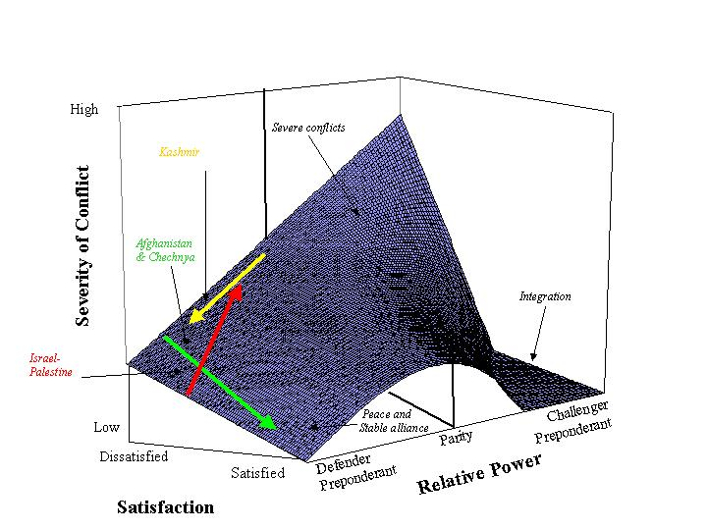
Power Transition Theory

Slide 76
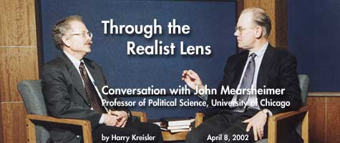

Slide 77
Discourses
Foucault argued that discourses
produce what we come to see as
real.
They determine what can (not just “may”)
be said, and even what can be thought.

